Slide 1


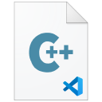
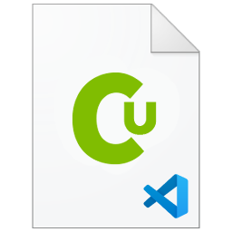


VSCode C/C++ Installation
DEV C++ / VS2022 / VSCode C/C++ Development environment
Clang$×$GCC $×$MSVC $×$DPC++ $×$CUDA
#MEI 00881036 TaiXeflar

Slide 2
Contents
Hardware Requirements
C/C++ release standard introduction
Dev C++
VS2022 with MSVC
VS2022 with Intel DPC++
VS2022 with NVIDIA NVCC
Environment PATH variables setup
VSCode with C/C++ Compile setup
Endnotes

Slide 3
C/C++ Installation – Hardware Requirements
We strongly recommend base hardware requirement on your PC:
CPU : Intel Pentium / AMD Athlon 2 Core @1.5GHz (require Hyper-Threading)
GPU: Intel UHD / AMD Radeon integrated Graphics
RAM : 4GB DDR4
Storage : 128GB SSD
OS: Windows 10 / Windows 11
Example: ASUS X412FA (Laptop)
CPU: Intel Core i5-8265U @2.5GHz 4 Core, 8 Threads
GPU: Intel UHD 630
RAM: 4+4 GB DDR4 Dual Channel
Storage: Intel 660P Series 512GB M.2 NVMe PCIe 3.0 SSD
OS: Windows 10

Slide 4
C/C++ Installation – Hardware Requirements
We recommend intermediate hardware specs on your PC:
CPU : Intel Core / AMD Ryzen 4 Core @2GHz or higher (require Hyper-Threading)
GPU: NVIDIA discrete GPU @2GB GDDR5 (Support NVIDIA CUDA)
RAM : 8GB DDR4 (recommend 16GB)
Storage : 512GB SSD
OS: Windows 10 / Windows 11
Example: ASUS X412FL (Laptop)
CPU: Intel Core i5-8265U @2.5GHz 4 Core, 8 Threads
GPU: Intel UHD 630, NVIDIA GeForce MX250 @2GB GDDR5
RAM: 4+4 GB DDR4 Dual Channel
Storage: Intel 660P Series 512GB M.2 NVMe PCIe 3.0 SSD
OS: Windows 10 / Windows 11

Slide 5
C/C++ Installation – Hardware Requirements
We recommend medium-high end hardware specs on your PC:
CPU : Intel Core / AMD Ryzen 6 Core @2GHz or higher (require Hyper-Threading)
GPU: NVIDIA discrete GPU @4GB GDDR5/GDDR6 (Support NVIDIA CUDA)
RAM : 12GB DDR4 (recommend 16GB)
Storage : 512GB SSD
OS: Windows 10 / Windows 11

Slide 6
C/C++ Installation – Hardware Requirements
PC | CPU (of Cores/Threads) | GPU (of GPU/VRAM) | RAM | SSD | OS | Environment
Basic | 4 Cores, 4 Threads | iGPU | 8GB | 128GB | Windows 10 | Dev C++
Medium | 4 Cores, 8 Threads | NVIDIA, 2GB | 8GB | 512GB | Windows 10 | Dev C++ VS2022
Performance | 6 Cores, 12 Threads | NVIDIA, 4GB | 12GB | 512GB | Windows 10 | Dev C++ VS2022
Note:
SSD either SATA or PCIe interface can provide faster boot loading, virtual memory, system cache loading speed than Hard Drive Disk.
Hyper-Threading technology enable 1 core for 2 Threads. Based on CPU architecture and BIOS/UEFI setup. For Intel Core 12th Gen CPUs contains P-core and E-core with only P-core support Hyper-Threading. Cores/Threads may be different.
iGPU is integrated GPU, such as Intel UHD, Intel Iris Xe, AMD Radeon Graphics in same chip package to CPU.
Discrete GPU condition requires CUDA GPU acceleration support. CUDA capable may different to your GPU setup.
RAM requires at least 4GB. Additional RAM add-on depends on Motherboard design. Recommend RAM set up is Dual-Channel Memory for data transfer more faster.

Slide 7
C/C++ Installation
We will use 6 kind of C/C++ compiler to build C/C++ tasks:
Provider | Environment | compiler | executable | standard
Microsoft | Visual Studio | MSVC | cl.exe | windows-msvc-x64
 |  | Clang/LLVM | clang-cl.exe | windows-clang-x64
Intel | oneAPI | DPC++/C++ | dpcpp.exe | gcc-x64
 |  | Classic C/C++ | Icl.exe | gcc-x64
NVIDIA | CUDA | CUDA Runtime | nvcc.exe | gcc-x64
GNU | -- | GCC | gcc.exe | gcc-x64
AMD Optimized C++ Compiler (AOCC) is for Unix-Like x64 system and no Windows support.

Slide 8
C/C++ Installation
We provide 3 IDE solutions to build C/C++ programming environment:
Dev C++ Installation (MinGW64)
Visual Studio 2022 Installation (MSVC, Intel C/C++ & DPCPP, NVIDIA CUDA C/C++)
Visual Studio Code(MinGW64, MSVC, Intel, NVIDIA)

Slide 9
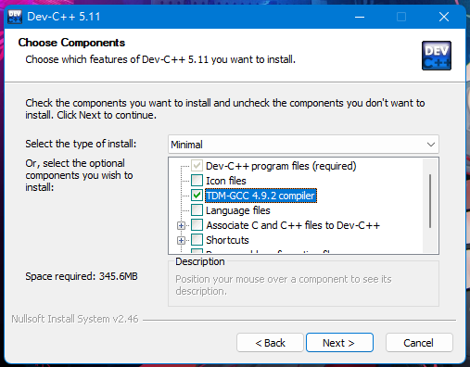
Dev C++ IDE installation
Dev C++ is free and open-source C/C++ compiler.
At least GCC Compiler must be choose via installation.

Slide 10
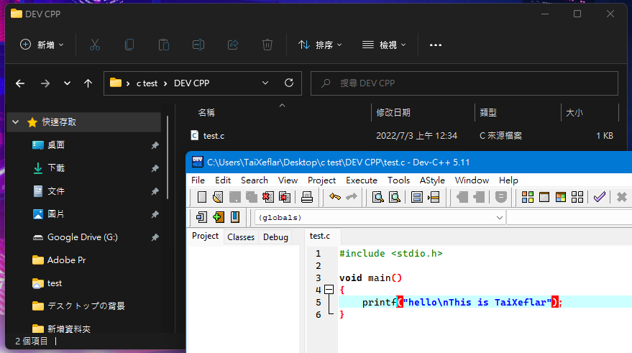
Dev C++ IDE development
Build up your project locations.
C program must be saved then can do compile to executable file.
After C program compile, run the program.

Slide 11


VS2022 C/C++ Installation
Go to Visual Studio website, download Visual Studio installer. For personal use, please select Community version.

Slide 12
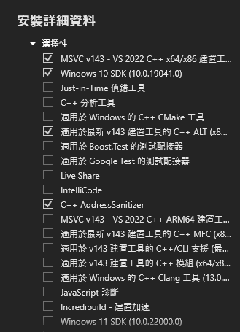

VS2022 C/C++ Installation (MSVC)
Begin Microsoft Visual Studio 2022 installation.
Install VS2022 Community Version.
Click up C++ development.
We will select the minimum development SDKs:
VS2022 MSVC v143 C/C++ build tools
MSVC v143 C/C++ ALT
Windows 10 SDK

Slide 13

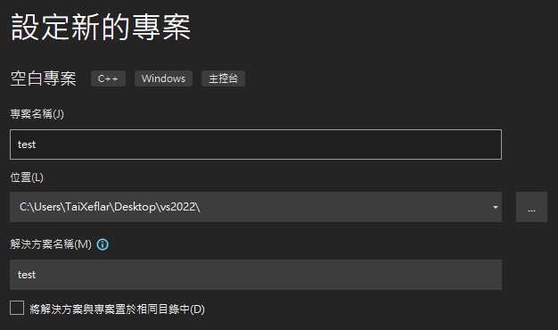
VS2022 C/C++ Project Build (MSVC)
Activate VS2022, choose C++ development, select blank project.
Now keep going setup your project’s name and storage locations (repository).

Slide 14
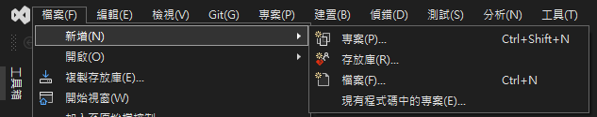
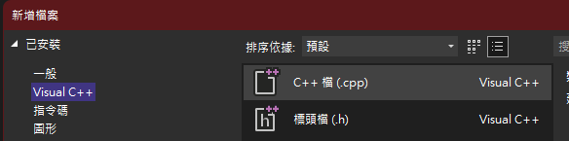
VS2022 C/C++ Project Build (MSVC)
We need build a new C/C++ file.
Go to File > New > Create New File.
Select Visual C++ > CPP File.

Slide 15
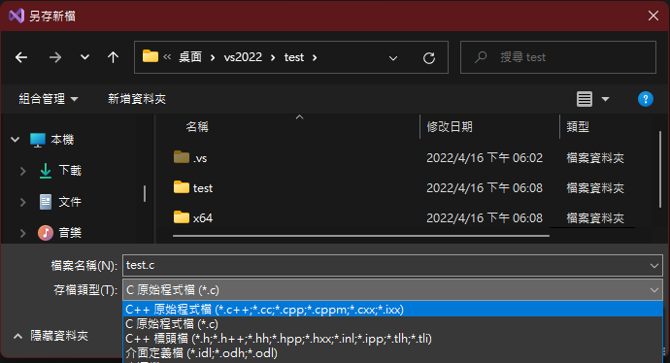
VS2022 C/C++ Project Build (MSVC)
After finish your C file, save as a new C source file.
Hot keys:
Save: “Ctrl + S”
Save as: “Shift + Alt + S”

Slide 16
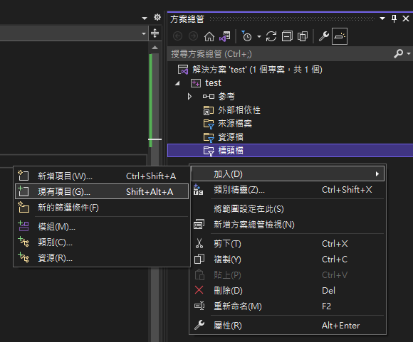

VS2022 C/C++ Project Build (MSVC)
At Explorer, add your c source file to headers/source file.
Where it should be look like this:

Slide 17
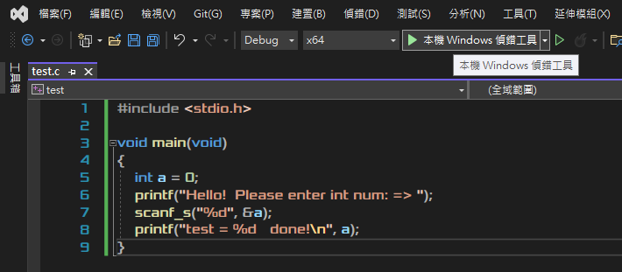
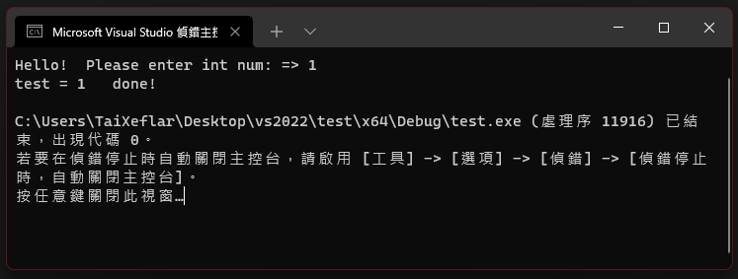
VS2022 C/C++ Project Build (MSVC)
Now we can do C source file compilation. Click on Local Windows debug tool.
If compilation successful, it should jump out a terminal like this:

Slide 18
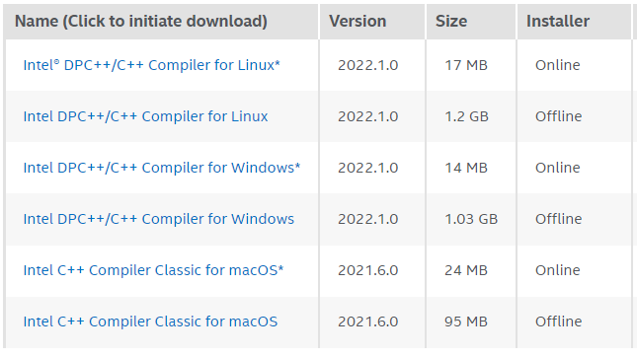
VS2022 C/C++ Project Build (Intel oneAPI)
Open Intel developer website, find Intel DPC++/C++ Compiler. Both DPC++ and Classic C/C++ compiler are included in installer.
Select offline installer.

Slide 19
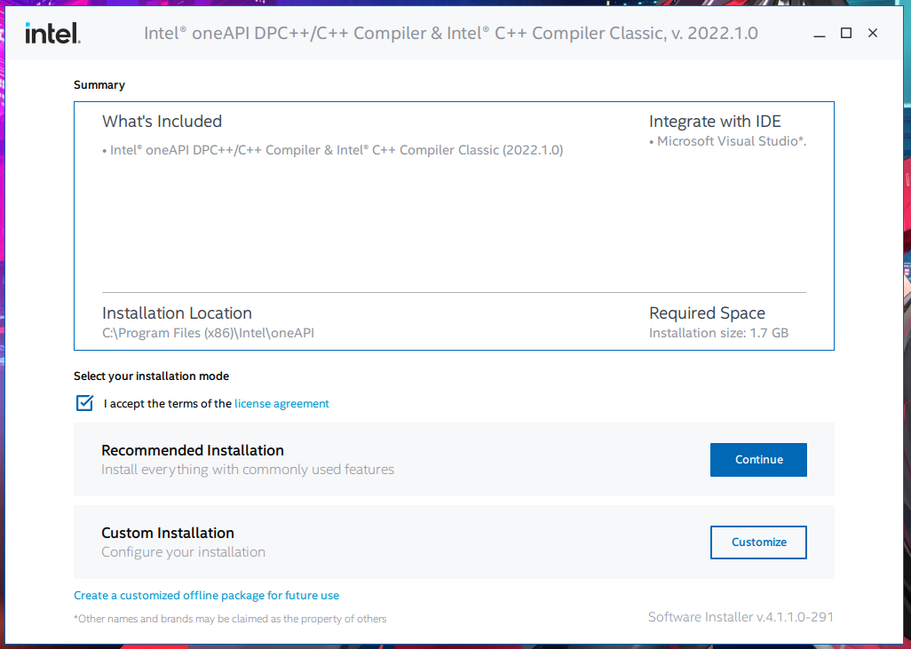
VS2022 C/C++ Project Build (Intel oneAPI)
Open Intel oneAPI installer, select “Recommend Installation” and license agreement, click continue.

Slide 20
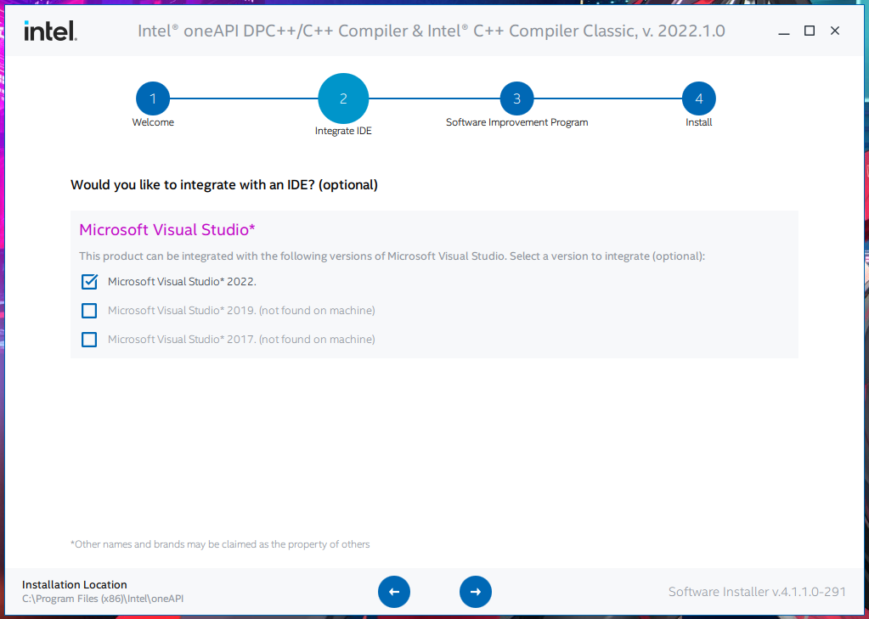
VS2022 C/C++ Project Build (Intel oneAPI)
If you would like integrate to Microsoft Visual Studio, select which version of VS you like.

Slide 21
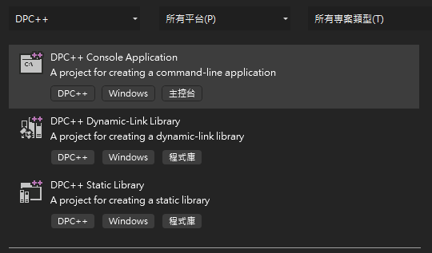
VS2022 C/C++ Project Build (Intel oneAPI)
After Installation, open VS2022 and build new project, select language “DPC++” to build intel oneAPI based C/C++ project.

Slide 22
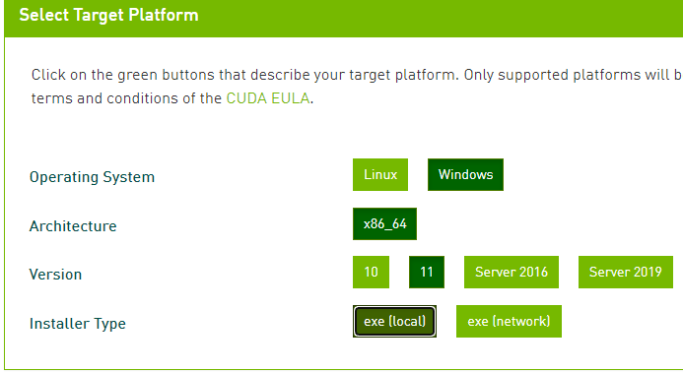

VS2022 C/C++ Project Build (NVIDIA CUDA)
Open NVIDIA developer site, find CUDA toolkit and select your PC’s architecture.
Please note that NVIDIA CUDA WHQL installer will require Visual Studio summary.
Warning: CUDA Development requires NVIDIA GPUs.

Slide 23
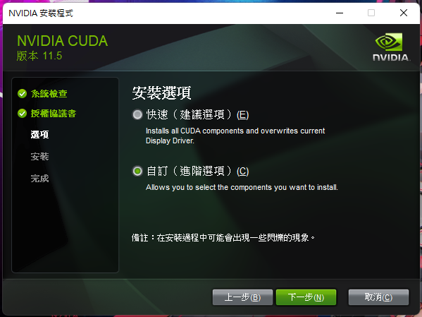
VS2022 C/C++ Project Build (NVIDIA CUDA)
After system check and license agreement, select customize installation.

Slide 24
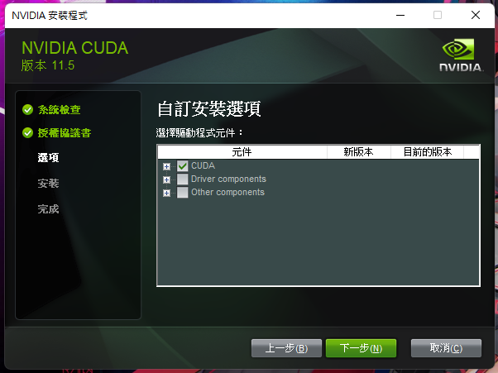
VS2022 C/C++ Project Build (NVIDIA CUDA)
Deselect these follow sections:
“Driver components”
“Other components”
“GeForce Experience”

Slide 25
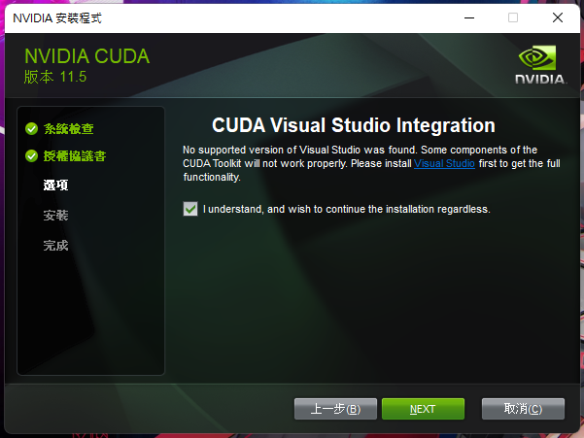
VS2022 C/C++ Project Build (NVIDIA CUDA)
In “CUDA” install section, we allow Installer install VS Integration. If Installer can’t find supported VS version, Installer will jump out this message. If you would like VS environment support, please install Visual Studio first, otherwise skip it.
VS2022 support:
CUDA 11.7 and later version
VS2019 support:
CUDA 11.3 and later version

Slide 26
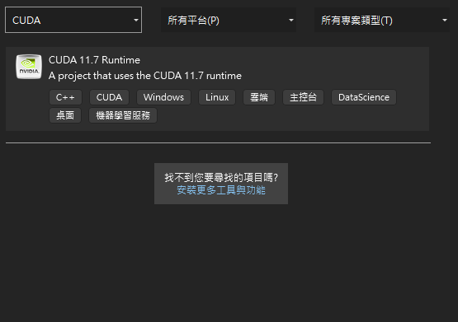
VS2022 C/C++ Project Build (NVIDIA CUDA)
After Installation, open VS2022 and build new project, select language “CUDA” to build NVIDIA CUDA runtime based CUDA C/C++ project.
This demonstration is VS2022 with CUDA 11.7 runtime version.

Slide 27
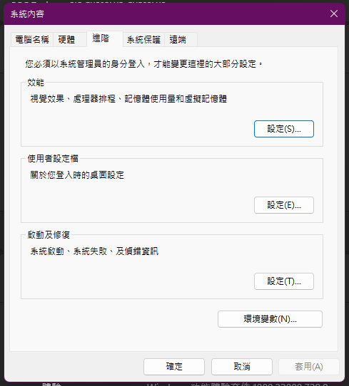
Configure VSCode C/C++ Compiler Path
Before we advanced to VSCode, we should check our System Environment Variables.
Add our C/C++ compiler’s file path to variable can accelerate our project compile’s speed and prevent unnecessary problems.

Slide 28
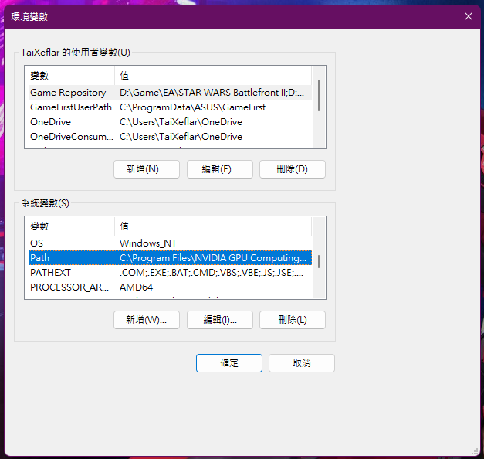
Configure VSCode C/C++ Compiler Path
In Environment Variables, find “Path” Variable in System Variables.
Then click “edit”.

Slide 29
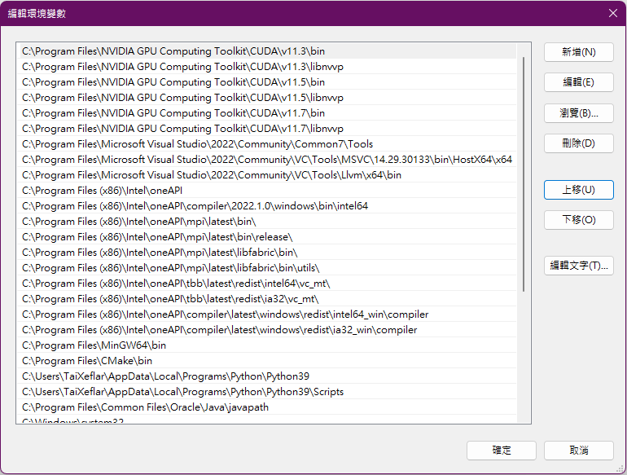
Configure VSCode C/C++ Compiler Path
Now we add our compiler’s file’s location to PATH. Make sure your path added successful, open terminal and paste compiler executable. If success, it should be something like result below: (next page)
CUDA | nvcc.exe
VS2022 | VsDevCmd.bat
 | cl.exe
 | clang-cl.exe
oneAPI | setvars.bat
 | icl.exe
 | dpcpp.exe
GNU GCC | gcc.exe

Slide 30
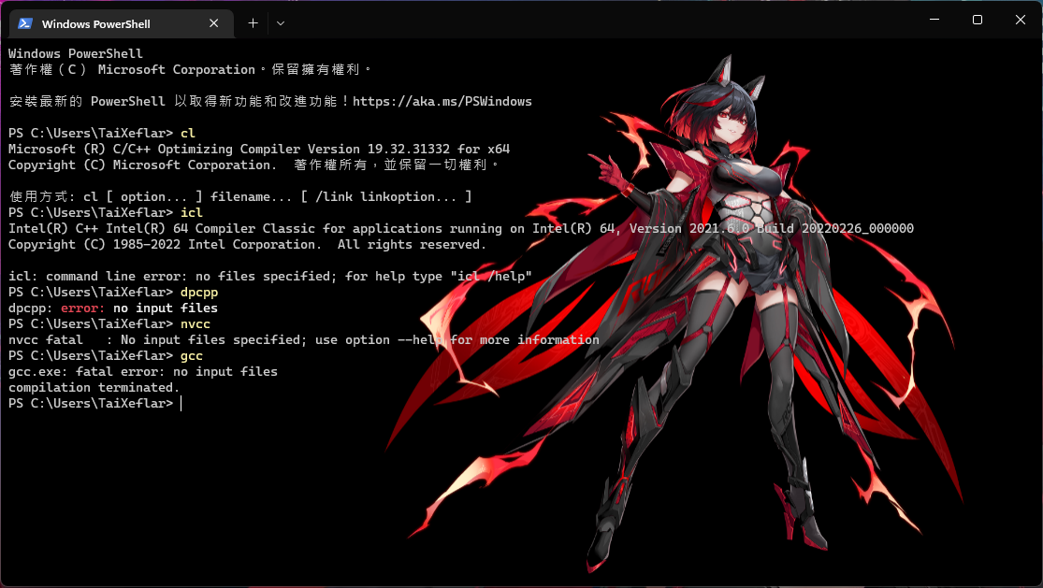
Configure VSCode C/C++ Compiler Path
Compiler Executable cl.exe icl.exe dpcpp.exe nvcc.exe gcc.exe clang.exe clang-cl.exe icx.exe

Slide 31
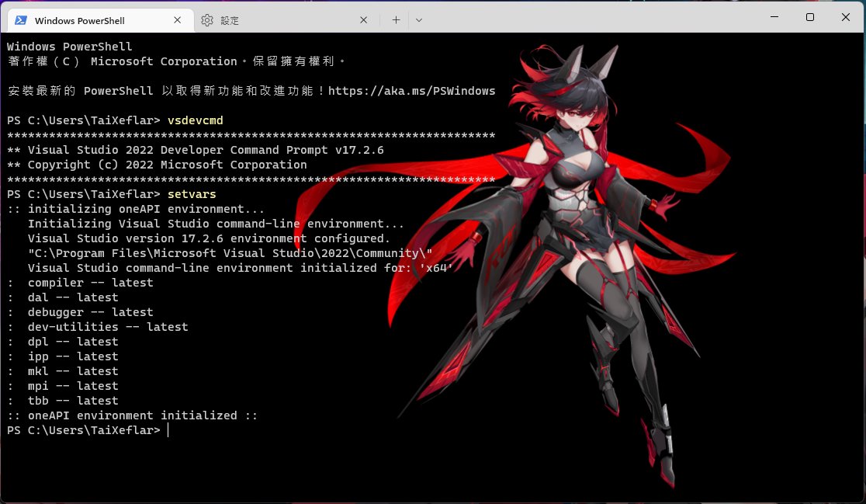
Configure VSCode C/C++ Compiler Path
Environment Batch VsDevCmd.bat setvars.bat

Slide 32


VSCode Installation
Now we begin our C/C++ develop configuration tasks in Visual Studio Code.
Visual Studio Code is an light weight, high extension and open source text editor from Microsoft. You can self-customize editor references, develop environment by just adjusting JSON file key pair values and parameters.
Happy Coding and Get It Now.

Slide 33
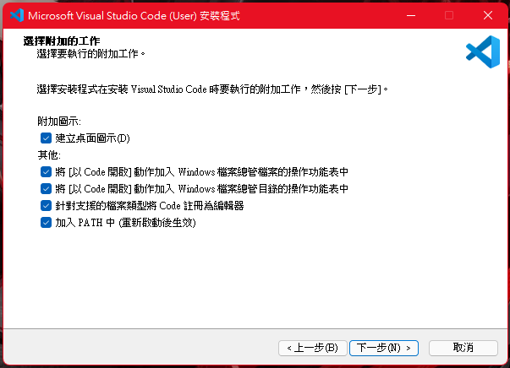
VSCode Installation
Register VSCode as supported files editor. This will enable open code files with vscode as default.
Add to PATH will enable shell environment (PowerShell, CMD) by execute “code .” command to launch VSCode in target folder.
VSCode have two versions installer for User or System installer. Please note the difference will cause install location in different path.

Slide 34
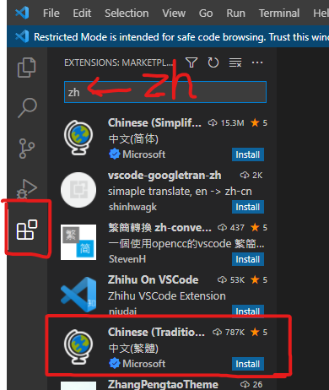


VSCode Installation
Enter VSCode, go to extensions, find your language pack.
If you persist for English interface, you can pass recommend install messages or disable it after install.

Slide 35

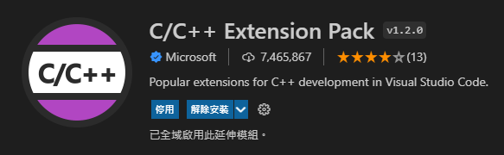
Configure VSCode C/C++ Compilation
Install Extensions:
C/C++
C/C++ Extension Pack
Language Pack: (Optional)
Traditional Chinese Language Pack
Japanese Language Pack

Slide 36
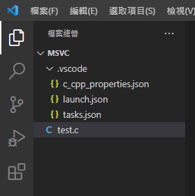
Configure VSCode C/C++ Compilation
Setup a folder to build your project.
Example:
C:/Users/YOU/Desktop/Project
In project file build these documents:
Project.c
.vscode(folder)
c_cpp_properties.json
tasks.json
launch.json

Slide 37
Configure VSCode C/C++ Compilation
c_cpp_properties.json:
Configuration of C/C++ intellisense mode.
tasks.json:
Configuration of C/C++ files compile setup.
launch.json:
Configuration of compiled C/C++ debug.

Slide 38
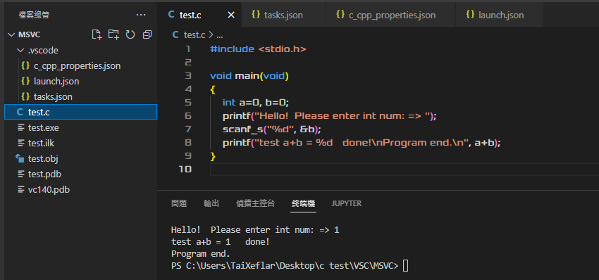
Configure VSCode C/C++ Compilation
After C/C++ file compile success, there will be an executable appear, and execute in integrated terminal (vscode integrated terminal) or extended terminal (windows terminal).
Build Task means “Do the compile task”.
Hot Keys:
Build Task: Ctrl+Shift+B
Debug: F5
Debug C/C++ Compiled Executable →
Terminal ↑

Slide 39
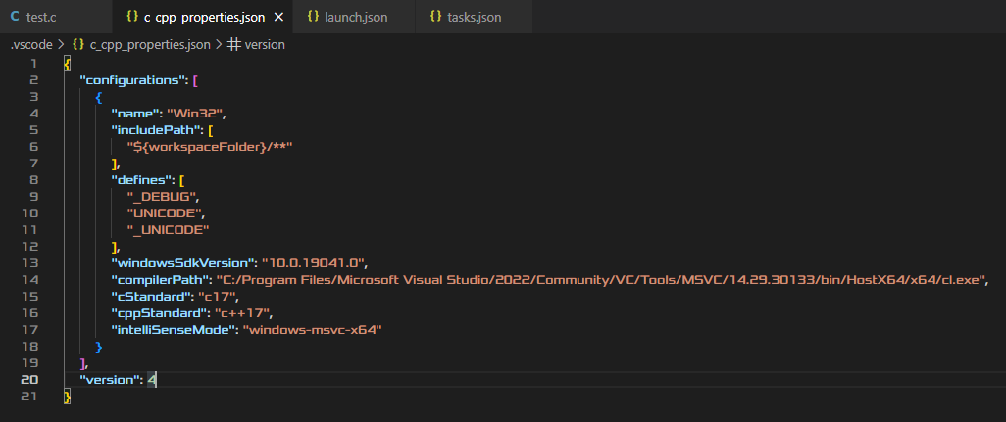
Configure VSCode C/C++ Compilation (MSVC)
c_cpp_properties.json

Slide 40
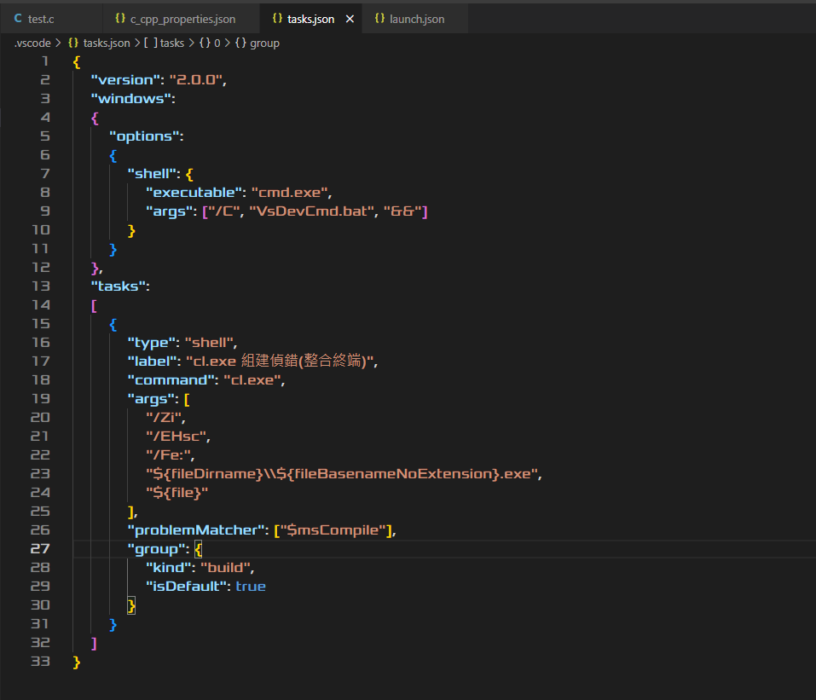
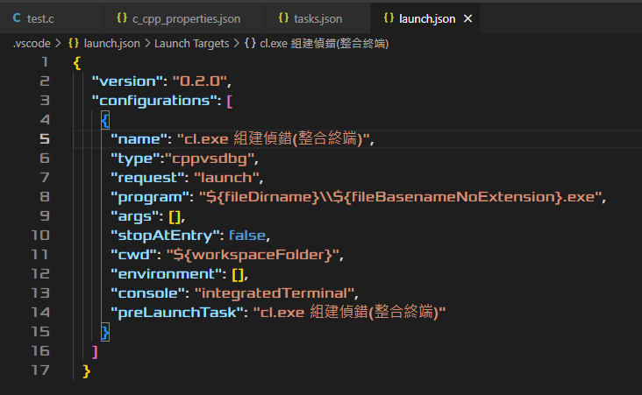
Configure VSCode C/C++ Compilation (MSVC)
tasks.json →
launch.json

Slide 41
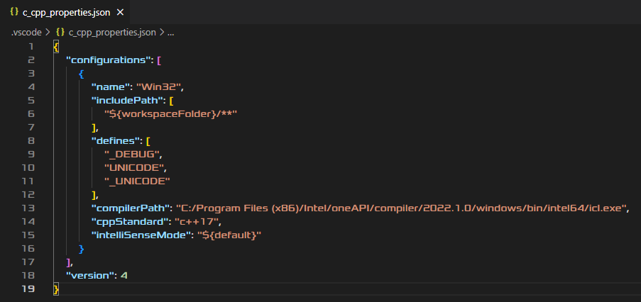
Configure VSCode C/C++ Compilation (ICL)
c_cpp_properties.json

Slide 42
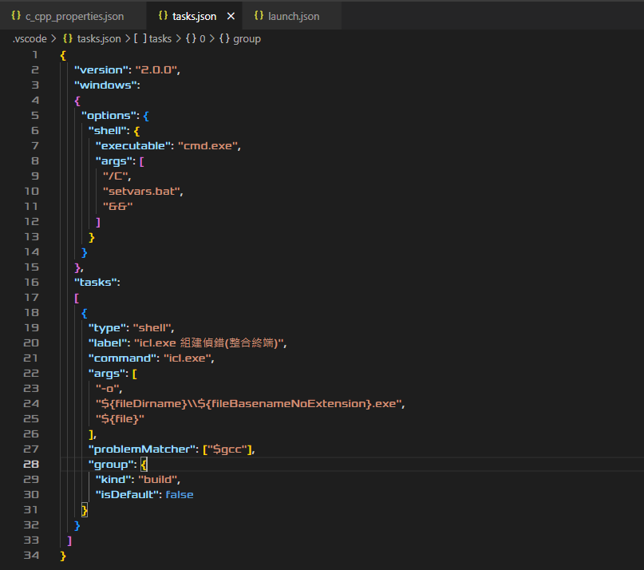
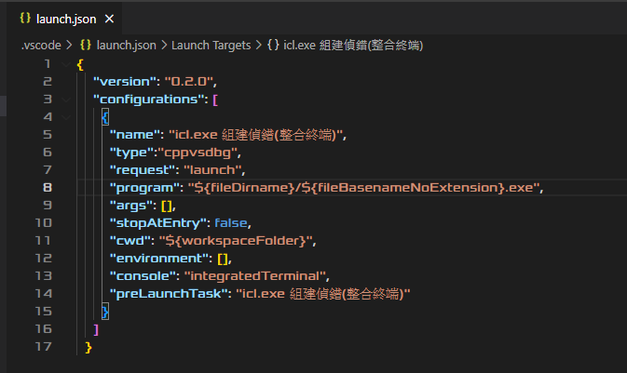
Configure VSCode C/C++ Compilation (ICL)
tasks.json →
launch.json

Slide 43
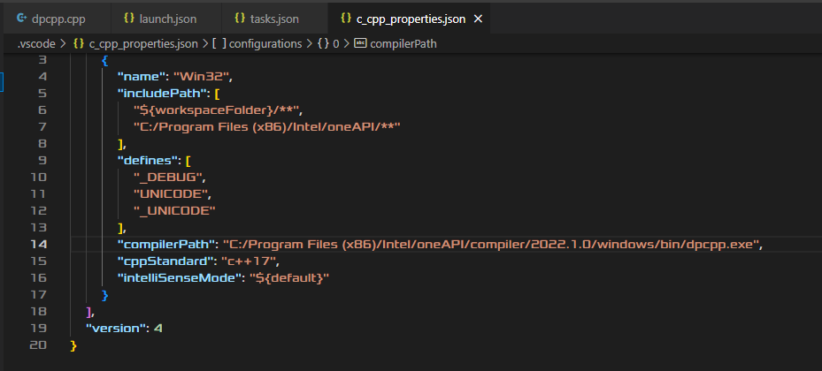
Configure VSCode C/C++ Compilation (DPC++)
c_cpp_properties.json

Slide 44
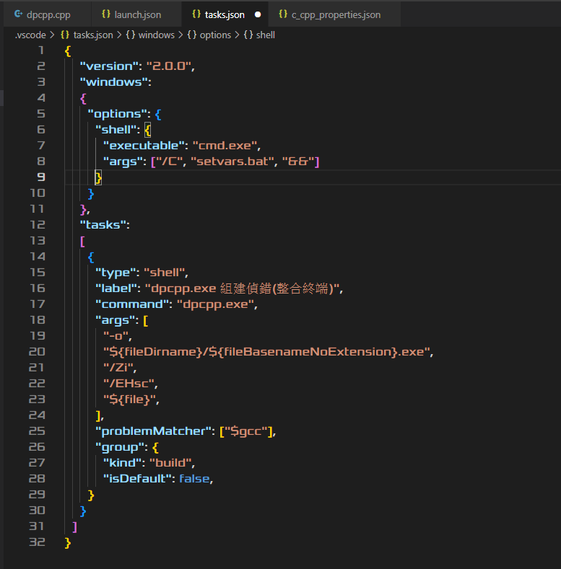
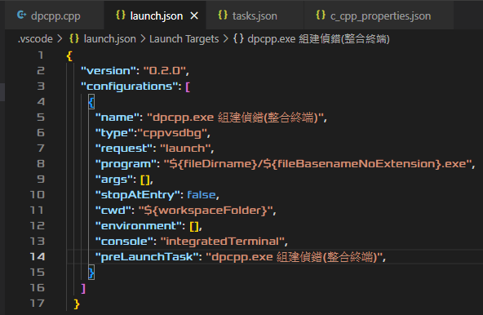
Configure VSCode C/C++ Compilation (DPC++)
tasks.json →
launch.json

Slide 45
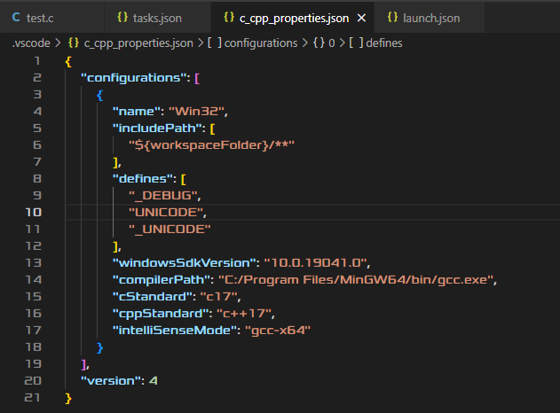
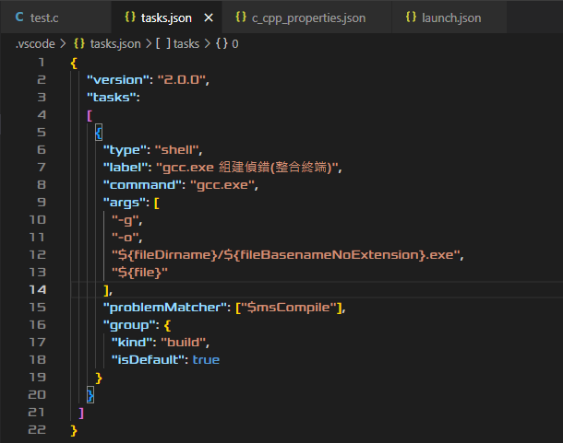
Configure VSCode C/C++ Compilation (GCC)
c_cpp_properties.json
tasks.json

Slide 46
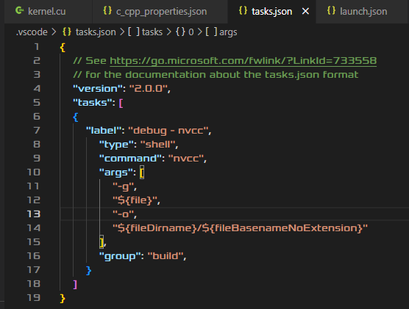
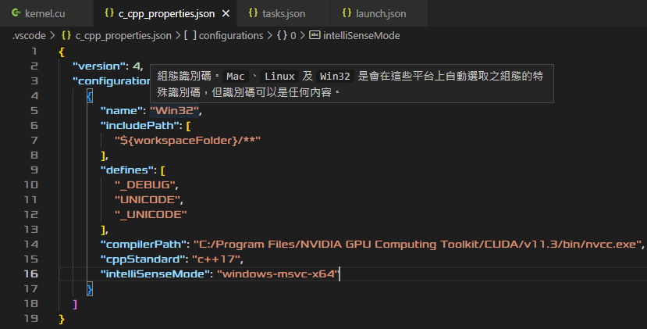
Configure VSCode C/C++ Compilation (NVCC)
c_cpp_properties.json
tasks.json

Slide 47
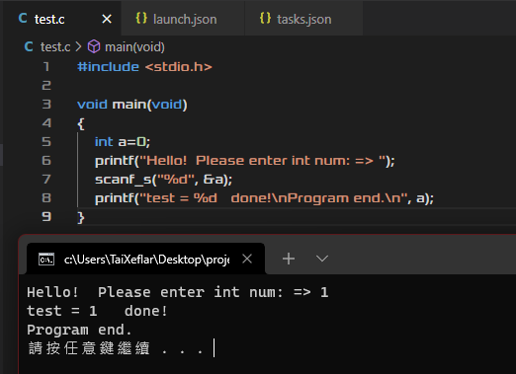
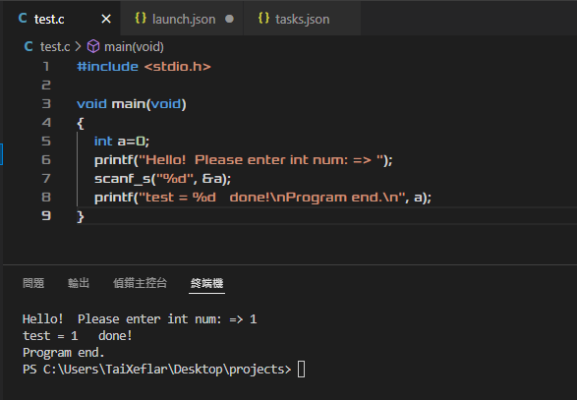
Configure VSCode C/C++ Compilation
In “launch.json”, key-pair value on “console” options can choose launch debugging terminals.
“console”: “integratedTerminal”
“console”: “extendedTerminal”
integratedTerminal
extendedTerminal

Slide 48
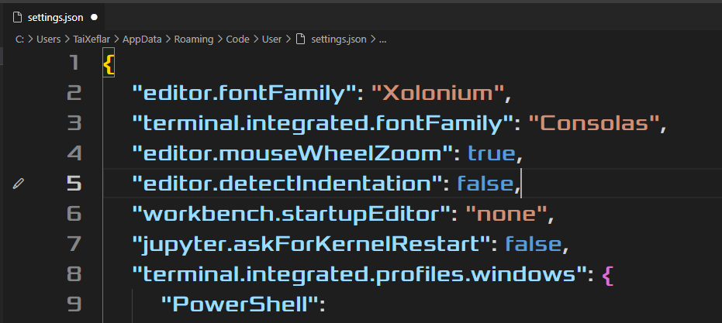
VSCode Customization
Open settings.json to customize our VSCode editor environment:
“editor.fontFamily”: Value must be installed Fonts.
“terminal.intergrated.fontFamily”: Value must be installed Monospaced Font.
“editor.mouseWheelZoom”: Value must be Boolean. This function is use “Ctrl + Mouse Wheel” to zoom text size.

Slide 49
Endnotes – References and Downloads
Dev C++: https://sourceforge.net/projects/orwelldevcpp/
VS2022 Download: https://visualstudio.microsoft.com/zh-hant/
VSCode Download: https://code.visualstudio.com/
Intel oneAPI DPC++ Download: https://www.intel.com/content/www/us/en/developer/articles/tool/oneapi-standalone-components.html#dpcpp-cpp
NVIDIA CUDA: https://developer.nvidia.com/cuda-downloads
Source:
https://code.visualstudio.com/docs/languages/cpp
https://code.visualstudio.com/docs/cpp/config-msvc

Slide 50
Endnotes – Tested Environment
Tested Environment: ROG Zephyrus S15 2020 (GX502LXS)
CPU: Intel Core i7-10875H @2.3GHz 8 Cores 16 Threads
iGPU: Intel UHD Graphics
GPU: NVIDIA GeForce RTX 2080 Super with Max-Q Design @8GB GDDR6
WHQL Driver: GeForce Game Ready Driver 512.96
RAM: Micron 32GB 3200MHz Dual channel memory
Storage: Samsung 970 Evo Plus 2TB SSD x2 3500/3300 MB/s
Operating System: Windows 11 Pro Workstation Edition
Windows 11 21H1 Home Edition Experience Pack 1000.22000.778.0 Stable Build

Slide 51
Endnotes – Tested Environment
Visual Studio Code: Version 1.16.9.
Visual Studio: Visual Studio 2022 Community version.
Developer Command Prompt for VS2022: VsDevCmd.bat
Microsoft Visual C++ Compiler: cl.exe 14.29.30133
Microsoft Visual C++ LLVM for Windows Compiler: clang-cl.exe
Dev C++: Version 5.11
GCC compiler: gcc.exe 4.9.2
Intel oneAPI: Intel oneAPI latest (2022.1.10)
Intel oneAPI DPC++ Compiler: dpcpp.exe
Intel oneAPI Classic C/C++ Compiler: icl.exe
NVIDIA CUDA C/C++: NVIDIA CUDA 11.7
NVIDIA CUDA C Runtime: nvcc.exe

Slide 52
Endnotes – Information & Disclaimer
Hardware recommendations are for reference only and requires may be different in action by system usage and foreground/background application usage. Higher requirement ensure system provides more CPU calculations, RAM space and disk load speed. Dual-Channel memory provide faster data transfer speed. High RAM volume enables project RAM usage can more larger. SSDs either SATA or PCIe interface are more faster(Boot loading, Virtual Memory, System Cache) than HDD. SSD load speed may effect by SATA/PCIe interface and RAID Volume.
This PowerPoint is only for education usage. Any company, products, logos and other mentioned products are for informational purposes only and may be trademarks of their respective owners.
Microsoft Visual C++ (MSVC) and Microsoft Visual C++ redistributable are release from Microsoft Visual Studio. Visual Studio Code, VSCode, Visual Studio Code logo, Visual Studio, VS2022, VS2019, VS2017, Visual Studio logo, Windows 10, Windows 11, Microsoft Visual C++, MSVC, Microsoft Visual C++ redistributable and other combinations thereof are registered logo, trademarks and products of Microsoft Corporation.
Intel DPC++/C++, Intel classic C/C++ compiler are combined/standalone release from Intel oneAPI toolkit. Intel, Intel Core, Intel Pentium, Intel UHD, Intel Iris Xe , Intel 660p series SSD, Intel oneAPI and other combinations thereof are products, registered logo and trademarks of Intel Corporation.
AMD Optimized C++ Compiler (AOCC) is for Unix-Like x86-64 system and targeted to AMD Zen series architecture EPYC server systems. AMD Radeon GCN, RDNA series GPU architecture not support CUDA acceleration. AMD, AMD Ryzen, AMD Athlon, AMD Radeon Graphics series and other combinations thereof are products and trademarks of Advanced Micro Devices, Inc.
NVIDIA CUDA runtime(NVCC) is release from NVIDA CUDA toolkit with NVIDIA CUDA C/C++ specified standard. Deep Learning, HPC, Parallel Compute toolkit may requires CUDA toolkit, CUDA runtime, cuDNN libraries and CUDA compatible NVIDIA GPU. NVIDIA, NVIDIA logo, GeForce, Quadro, Titan, MX, GTX, RTX, CUDA, cuDNN are trademarks and products of NVIDIA Corporation.
Micron, Micron Crucial DRAM, Micron Crucial SSD are products and trademarks of Micron Technology, Inc.
Samsung, Samsung 970 Evo Plus SSD are combinations thereof are products and trademarks of Samsung Electronics.
ASUS, ASUS Vivobook, ROG, ROG Zephyrus are products and trademarks of ASUS Tek, Inc.

